Slide 1
Dividends, repurchases, and splits
Chapter 13

Slide 2
Learning Objectives
Learn about Distributions
Learn about Dividends
Learn about Stock Repurchases
Learn about Stock Splits

Slide 3
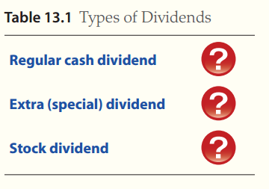
LO1: Distributions
A distribution is a payment to shareholders
There are two main types of distributions
  Dividends
  Share repurchases
Notes:
Explain It text boxes on p.13.1.1 provide an introductory tutorial on the types of dividends.

Slide 4
Distributions
Cash dividends
  Most common distribution
  Typically paid quarterly
Stock dividends
  Not cash, but additional shares in the company

Slide 5
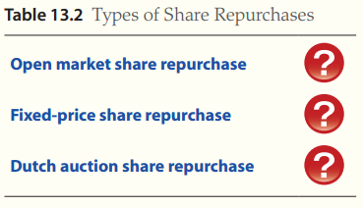
Types of Share Repurchases
Share repurchase
  The company buys back some of its shares to reduce the number of outstanding shares
A company instructs its broker to buy shares on the open market at existing prices.
The company makes an offer to buy a fixed quantity of shares at a fixed price.
The company announces a target repurchase quantity and invites shareholders to offer their shares for sale.
Notes:
Explain It text boxes on page 13.1.2 provide examples of the three types of repurchase methods.

Slide 6
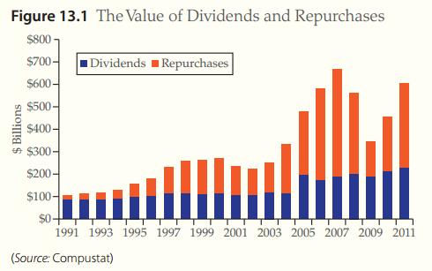
A History of Dividends and Repurchases
Repurchases are more volatile than dividends
Repurchase value varies with business cycle
Notes:
Managers often justify a repurchase by indicating their belief the stock is undervalued. Figure 13.1 from page 13.1.3.

Slide 7
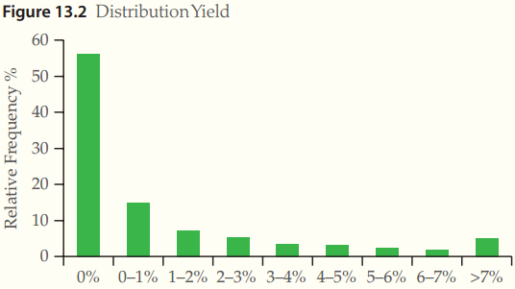
Yields
Distribution Yields
  Most companies (56%) have a yield of 0%
  Median yield for all companies is 1.9%
Distribution Yield
Notes:
As you can see, most firms do not pay dividends. Figure 13.2 from page 13.1.4.

Slide 8
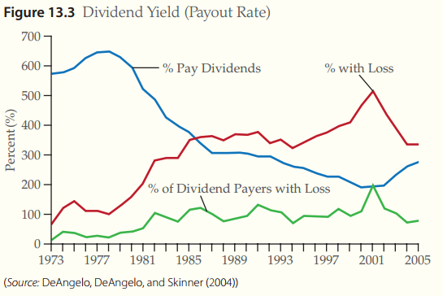
Who Makes Distributions?
A small number of companies pay most of the dividends, and generate the most earnings
Notes:
Generally only a few large firms make up the bulk of the distributions. Figure 13.3 from page 13.1.5.

Slide 9
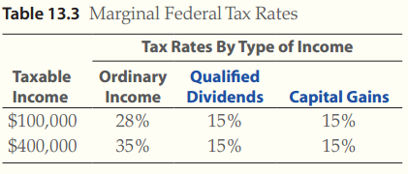
Taxes on Dividends and Capital Gains
Stockholders pay tax on the dividend the year the dividend is paid
2012 tax rate for dividends
Notes:
Tax rates change frequently thus changing preferences for distributions. Table 13.3 from page 13.1.6.

Slide 10
Clienteles
Different groups of investors that have different distribution preferences
Prefer types of distribution with the lowest tax rate
Notes:
Dividend clientele has been widely tested in the literature and found to hold in many cases.

Slide 11
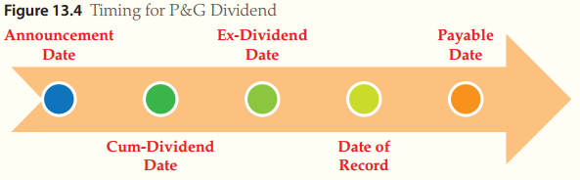
LO2: Dividends
Dividend Mechanics and Timing
  Payments of dividends must be broadly disseminated by the investors
  Typically done through newswire releases
Announcement Date is the date the dividend is announced.
Cum-Dividend date is three business days before the date of record.
Ex-Dividend date is 2 business days before the date of Record.
Date of Record is the day when the list of registered owners is created.
Payable Date is the date the dividends are distributed to owners.
Notes:
Spend some time going over the mechanics of this process from announcement to payment. Figure 13.4 is interactive and can be found on page 13.2.1 of the text.

Slide 12

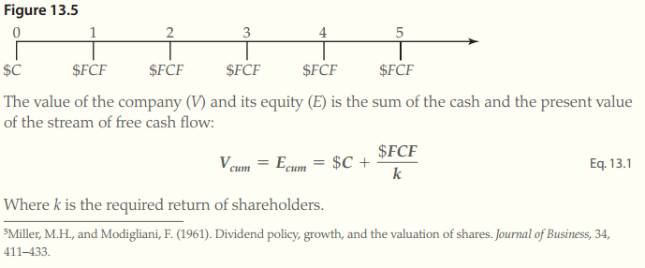
The Impact of Dividends on the Stock Price
Timeline of cash flows and value equation
Notes:
Figure 13.5 from page 13.2.2 of text.

Slide 13
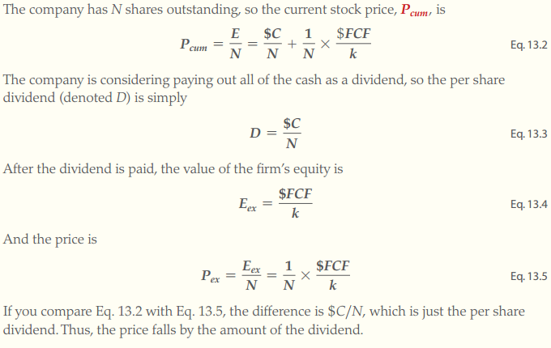
The Impact of Dividends on the Stock Price
Notes:
Formulae from page 13.2.3 of text.

Slide 14
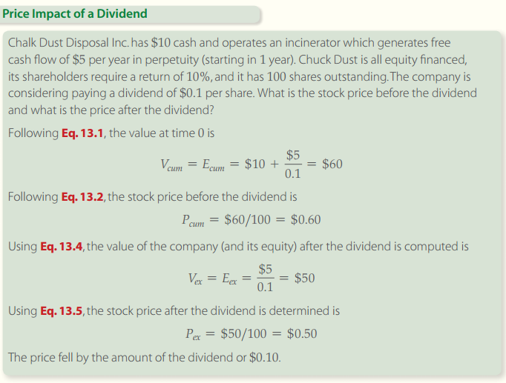
The Impact of Dividends on the Stock Price
Notes:
Solution tools on page 13.2.4 of text.

Slide 15
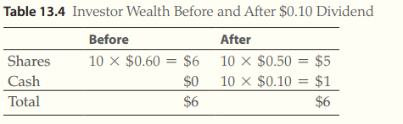
The Impact of Dividends on the Stock Price
Notes:
Note that investor wealth is unchanged. Table 13.4 from page 13.2.5 of text.

Slide 16
Other Factors Affecting Dividends
Taxes
  If dividend tax rates are higher than capital gain tax rates, then the price will fall by less than the amount of the dividend on the ex-dividend day
Information Asymmetries & Signaling
  Sustainable earnings
    Good predictors of future earnings
    Managers increase dividends when they expect higher future earnings
Signaling hypothesis
  Dividend increases should cause an increase in stock price

Slide 17
Empirical Evidence About the Price Reaction of Dividends
Dividend Decrease
  One tenth the likelihood of a dividend increase
  A negative market reaction is focused on dividend reductions by firms that have experienced recent decline in earnings
Dividend Increase
  Convey positive market information
(Note: Negative signals are stronger than positive signals because investors believe managers will exhaust all possibilities before cutting a dividend.)
Notes:
Negative signals are stronger than positive signals because investors believe managers will exhaust all possibilities before cutting a dividend.

Slide 18
Dividend Policy
Dividend decision is affected by:
  The need for cash
  Taxes
  Asymmetric information (signaling)
  Agency Problems
Stable Dividends
  Policy of keeping dividends steady
  Dividends only increase IF earnings rise to a ‘sustainably’ higher level

Slide 19
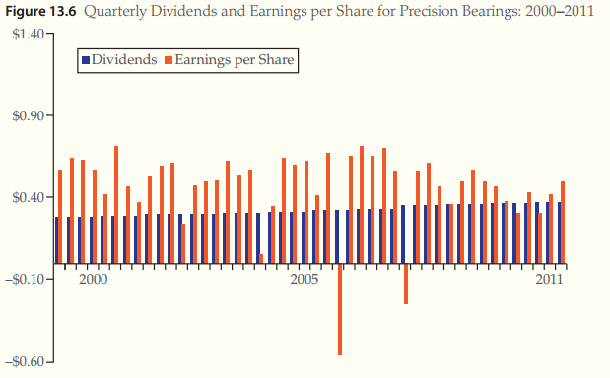
Dividend Policy
Notes:
Note that dividends are much more stable than earnings. Figure 13.6 from page 13.2.12 of text.

Slide 20
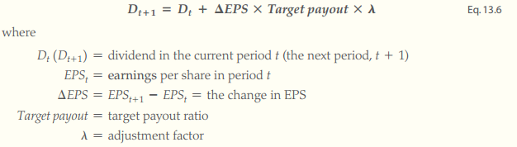
Dividend Policy
Target Payout Policy: Total Div./Net Income (NI)
  Target payout model
Notes:
Equation 13.6 from page 13.2.13 of text.

Slide 21
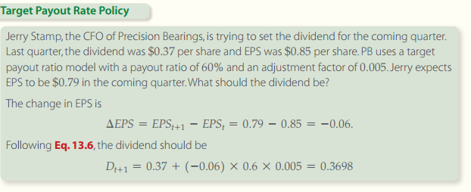
Dividend Policy
Notes:
Solution tools on page 13.2.14 of text.

Slide 22


Dividend Policy
Residual Dividend Policy
  Recognizes that internal equity is a cheap source of project financing and sets dividends as a leftover
  Residual dividend formula
Notes:
Not as easy to predict, so not as widely used.

Slide 23
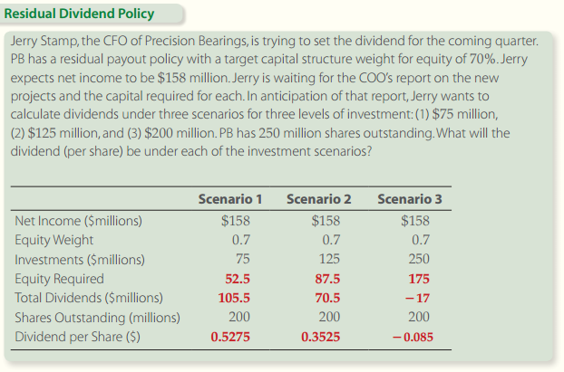
Dividend Policy
Notes:
Solution tools on page 13.2.16 of text.

Slide 24
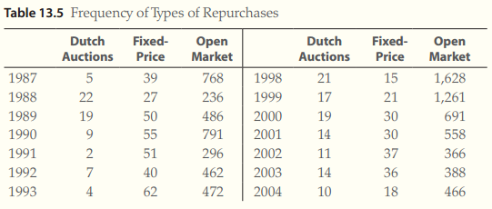
LO3: Stock Repurchases
In an open market repurchase, the firm instructs it’s broker to buy share in the Open Market at the prevailing market price. The shares are then cancelled and the number of shares outstanding is reduced.
Types of Repurchases:
Notes:
Table 13.5 from page 13.3.1 of text.

Slide 25
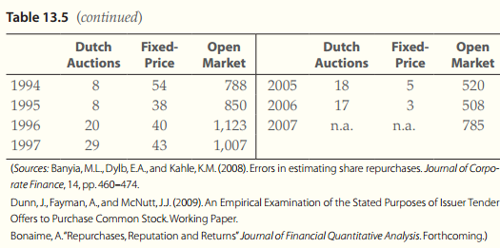
Repurchase Mechanics and Timing
Types of repurchases (cont.)
Notes:
This table provides good information on the frequency of various types of repurchases. You can see that open market repurchases are the preferred method. From page 13.3.2 of text.

Slide 26
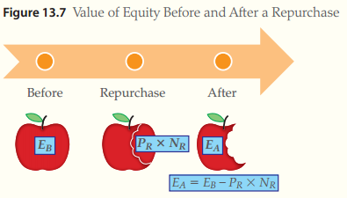
Price Reactions to Stock Repurchases
Notes:
Figure 13.7 is interactive and from page 13.3.4 of the text.

Slide 27

Price Reactions to Stock Repurchases
  After repurchase the value of a firms equity is equal to the value of the equity before repurchase minus the cost of the repurchase
  Before repurchase equity is equal to stock price times shares outstanding
  The value of the equity after the repurchase
  Price after repurchase
Notes:
Note that investor wealth should not change. Equations from pages 13.3.4 and 13.3.5 of text.

Slide 28
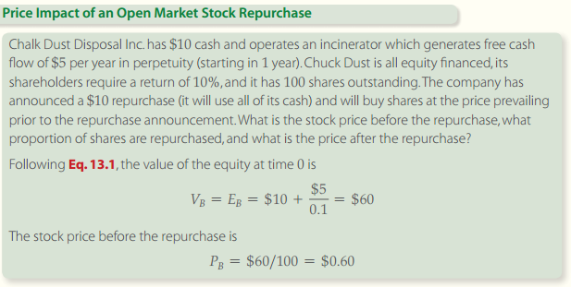
Price Reactions to Stock Repurchases
Notes:
Solution tools on page 13.3.6

Slide 29
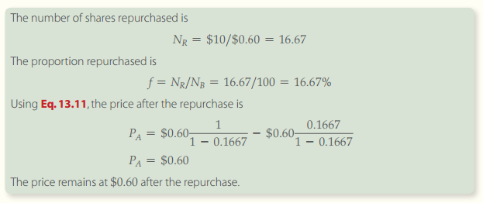
Price Reactions to Stock Repurchases
Notes:
Continued from page 13.3.7 of text.

Slide 30
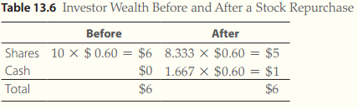
Price Reactions to Stock Repurchases
Wealth impact on repurchase
EPS
  Repurchases increase earnings per share (EPS). This is logical because you have the same level of earnings being allocated over a smaller number of shares.
Notes:
No change in investor wealth as seen in Table 13.6 from page 13.3.8 of text.

Slide 31
Taxes, Asymmetric Information and Agency Problems
A debt financed repurchase will substantially change leverage
Repurchases have been proposed as signals of future earnings
Repurchases remove free cash flow from wasteful managers
Notes:
In the absence other investment opportunities, a repurchase may be a good use of funds.

Slide 32
Stock Repurchase Policy
Flexibility hypothesis
  Repurchases do not raise expectations and implicitly commit the firm to future payouts
  This gives companies more flexibility to use repurchases selectively
Stock Options
  Repurchases leave the price of stocks unchanged (initially) so may be preferred to dividend distributions
  There exists a positive relationship between repurchases and management stock options

Slide 33

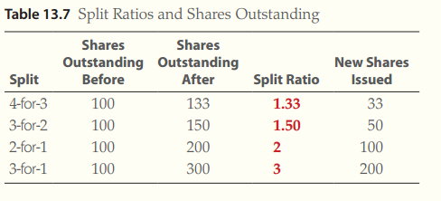
LO4: Stock Dividends and Splits
Split ratio
Notes:
The most common split ratio is 2-for-1, as seen in Table 13.7 from page 13.4.1 of text.

Slide 34


The Price Impact of a Stock Split
Price after a split
  is equal to the price before split divided by the number of splits
  Where
    P_{A} is Price after split
    P_{B} is Price before split
    S is the number of splits
Notes:
Splits do not change the value of the firm.

Slide 35
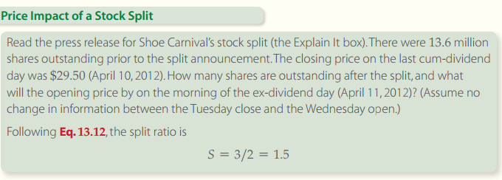
The Price Impact of a Stock Split

Slide 36
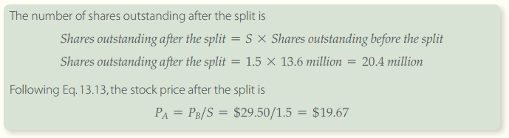
The Price Impact of a Stock Split
Example continued
Notes:
From pages 13.4.2 and 13.4.3 of text.

Slide 37
Motive for Stock Splits
Benefits
  Stock prices move to a lower trading range
  Particularly relevant since stocks typically trade in board lots
Board lot
  100 shares
  Less price volatility than odd-lots
  Also called a round lot
Odd-lot
  Less than one board lot

Slide 38
Reverse Split
Occurs
  When a company reduces the number of shares held by each shareholder by the same proportion
  The price of stock will increase
Reasons for higher stock prices
  Some stock exchanges will de-list a stock if it trades below a price of $1 for too long
  Some brokerages will not lend to investors (for margin purchases) if the stock trades below a threshold price (i.e. $3)
Notes:
Again, no change in the value of the firm.

Slide 39
End of 13

Slide 40
Financial Planning
Chapter 14

Slide 41
Learning Objectives
Learn how to forecast sales
Learn how to forecast cash sources and uses
Learn how to forecast financial statements
Learn how to manage additional funds needed

Slide 42
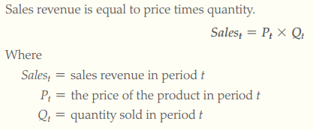
LO1: Sales Forecast
Basic Sales Forecast

Slide 43
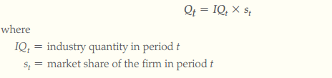
Basic Sales Forecast
Driver
  An underlying economic factor that determines the future path of the variable
Quantity Forecast
  The quantity in any year t is given by
Notes:
Think about some product drivers and discuss them in class. Pick a product as an example; ask the class to brainstorm drivers.

Slide 44
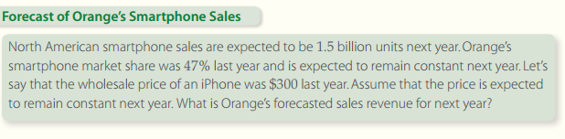
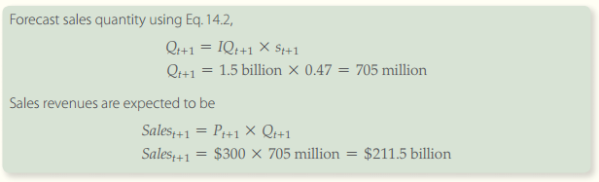
Basic Sales Forecast
Notes:
Example from pages 14.1.2 and 14.1.3 of text.

Slide 45
Sales Forecast for Retailers
Same-stores sales growth (SSSG)
  The growth in sales per square foot
SSSG Will likely rise with inflation
Competition leads to slow price growth
Notes:
SSSG will rise with inflation, so may not indicate increased unit sales.

Slide 46
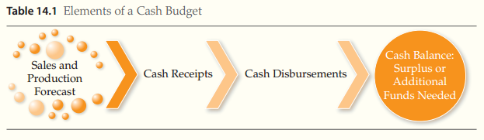
LO2: Cash Budget
Cash budget
  Detailed statement of cash inflows and outflows
Notes:
The cash budget is critical to financial managers since they may need to line up sources of funds for periods of cash shortage.

Slide 47
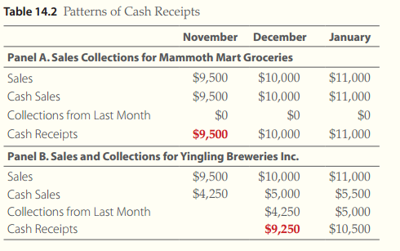
Cash Receipts
Not all sales generate immediate cash receipts. Sales and cash receipts are identical for Mammoth because everything is sold for cash at the groceries.
The Sales and cash sales vary for Yingling because they extend credit terms to their buyers.
Notes:
Identify all cash inflows. Example from page 14.2.3 of text.

Slide 48
Cash Disbursements
Payments and inputs for supplies
Operating expenses
  Wages, rent, taxes, selling, general and administration expenses
Capital expenditures
  Purchases of fixed assets
Financing expenses
  Interest, dividends, stock repurchases, and repayment of principal
Notes:
Identify all cash outflows.

Slide 49
Cash Disbursements
Payments to suppliers
  Payments to suppliers are modeled in two steps
    The purchase
    The payment of accounts payable

Slide 50
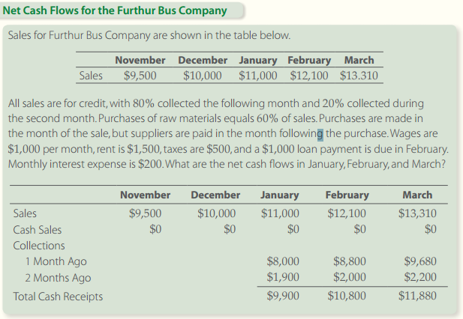
Net Cash Flow : Cash Receipts
20%
80%
Notes:
Solution tools from page 14.2.5 of text.

Slide 51
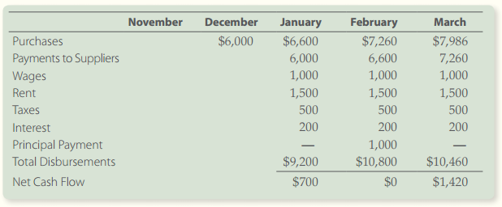
Net Cash Flow: Cash Disbursements
Notes:
The net cash flows are calculated with information from the previous slide. Page 14.2.6 of text.

Slide 52
Cash Balance: Surplus or Additional Funds Needed
Cash balance
  The amount of cash in the cash account
  Most firms establish a desired minimum cash balance
Ending cash balance
  The beginning balance plus the net cash flows during the month

Slide 53
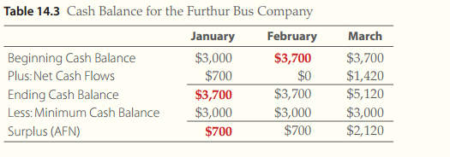
Cash Balance: Surplus or Additional Funds Needed
Note that you carry the ending balance to the beginning of the next period. In this case, you anticipate a cash surplus and will likely invest the monies short-term.
Notes:
Note that you carry the ending balance to the beginning of the next period. In this case, you anticipate a cash surplus and will likely invest the monies short-term.

Slide 54
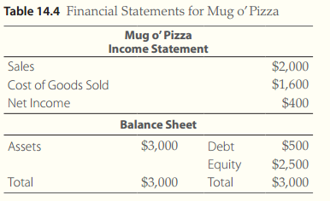
LO3: Financial Statements Forecasting
STOP
Percent of Sales (POS) method
  Most accounts are related to sales
  Sales forecasts are used to generate forecasted statements
Notes:
Table 14.4 from page 14.3.1 of text.

Slide 55
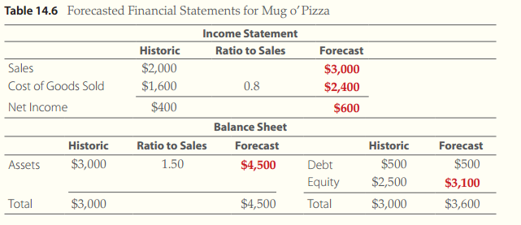
Simple Forecast
Notes:
Table 14.6 from page 14.3.3 of text with solution tool (excel spreadsheet).

Slide 56
Simple Forecast
AFN
  Capital shortfall created when the balance sheet does not balance
Plug account or plug variable
  Created by adding AFN to one of the accounts
  Used to make the balance sheet balance

Slide 57
Forecasting Accounts Not Tied to Sales
Interest
Depreciation
Capital expenditures (CAPEX)
Net fixed assets
  net and property plant and equipment
Notes:
These accounts do not vary directly with sales.

Slide 58
Forecasting Accounts Not Tied to Sales
Interest Expense
  Interest expense is tied to debt rather than sales
  The term (PV_{t-1} x 1) is the interest earned (paid) over the period t
  The same equation can be used to forecast interest
Notes:
Depends on current level of debt, which is independent of future sales.

Slide 59


Forecasting Accounts Not Tied to Sales
Depreciation
  Depreciation expense is related to fixed assets
  Declining balance depreciation system
      Deducts a fixed percentage of an assets value each year
Notes:
Also independent of future sales, since it is related to previous asset purchases.

Slide 60

Forecasting Accounts Not Tied to Sales
Net Fixed Assets
  When an asset is depreciated, regardless of method, the value of net fixed assets at the end of any year t is given by
  When companies add fixed assets during the year (CAPEX)

Slide 61
Forecasting Accounts Not Tied to Sales
CAPEX
  Capital Expenditures
Maintenance CAPEX
  Assets that are purchased to replace worn out equipment
Growth CAPEX
  Assets that must be purchased in order to grow sales
Notes:
Growth CAPEX must be considered for most expansions. In general you will need additional capital expenditures to support higher sales, although CAPEX is lumpy.

Slide 62
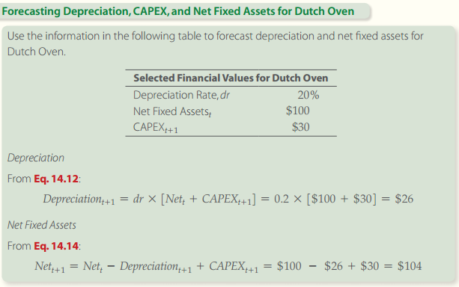
Forecasting Accounts Not Tied to Sales
Notes:
Solution tools on page 14.3.8

Slide 63
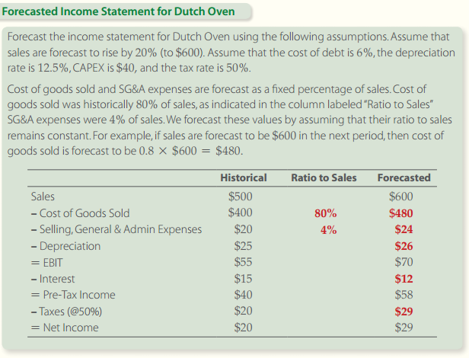
Income Statement Forecast
Notes:
Now we have the components to forecast income. See solution tools on page 14.3.10

Slide 64
Income Statement Forecast
Statutory rate
  Taxes can be calculated using statutory rates
Apparent tax rate
  Can also be use to calculate taxes
  Reflects any tax credit or special rates enjoyed by the company

Slide 65
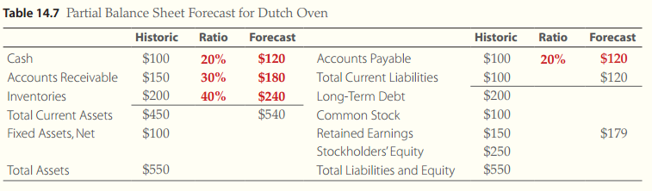
Balance Sheet Forecast
Current Assets and Liabilities
  Forecast as a percentage of sales
  The turnover and payable ratios are assumed
  to remain constant
Notes:
You can use historical percentages and assume they will remain consistent. Table from page 14.3.12 of text.

Slide 66
Balance Sheet Forecast
Long-Term Assets
  Common long term assets include
    Goodwill
    Patents
    Intangibles
Debt and Equity-The Plug Variables
  Not forecast as a percentage of sales
  Determined as a matter of financial policy
Notes:
Long-term assets (such as goodwill, patents, etc.) should not fluctuate with sales.

Slide 67
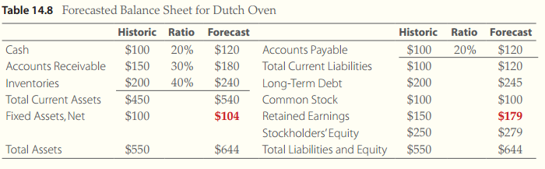
Balance Sheet Forecast
Notes:
Table 14.8 from page 14.3.14 of text. Note the expected increase in retained earnings.

Slide 68
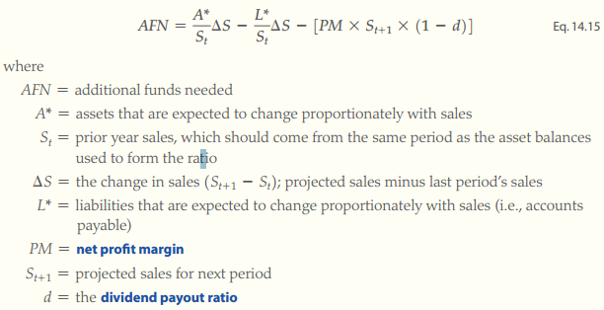
LO4: Additional Funds Needed and Growth
The Equation Approach
  Computing AFN
Notes:
Much easier to use than POS and gives close to the same estimate of AFN. See page 14.4.2 of text.

Slide 69
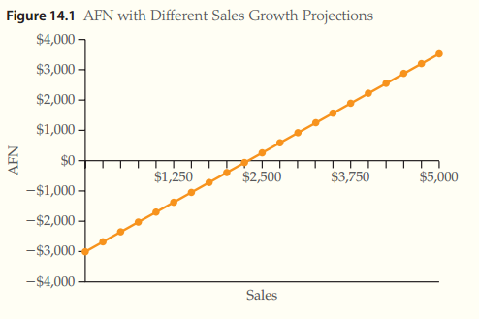
Additional Funds Needed and Growth
Notes:
As sales increase, so does the need for lining up funds in advance. AFN graph from page 14.4.4 of text.

Slide 70
Additional Funds Needed and Growth
To determine AFN
  We can use forecasted financial statements
  We can use the equation given earlier
Advantages of forecasting statements
  Allows for changes in relationship between sales and asset and liability accounts
  It allows us to model lumpy capital expenditures, operating leverage and economies of scale

Slide 71

Projecting the Maximum Internal Growth Rate
Maximum internal growth rate (MIGR)
  The highest rate that sales can grow without the firm needing additional funds
  The growth that can be achieved with only internal funding
MIGR equation
  ROA is return on assets
  d is the dividend payout ratio
Notes:
Firms can grow too fast so the MIGR is important. From page 14.4.5 of text.

Slide 72
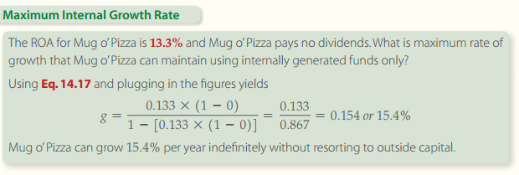
Maximum Internal Growth Rate
Notes:
Solution tools on page 14.4.6 of text

Slide 73

Projecting the Maximum Sustainable Growth Rate
Maximum sustainable growth rate (MSGR)
  The highest growth that a firm can sustain using only internal equity
MSGR Equation
Notes:
Eq. 14.18 from page 14.4.7 of text.

Slide 74
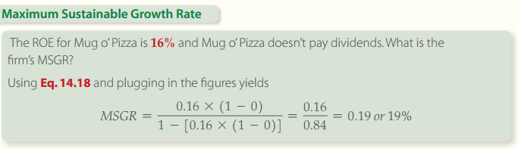
Projecting the Maximum Sustainable Growth Rate
Notes:
From page 14.4.8 of text. Solution tools, excel video and spreadsheet, are provided to explain MSGR.

Slide 75
How to Influence Growth Rate
Profit margin
  The greater the profit on sales, the more cash is available to finance growth
Total asset turnover
  The more rapidly assets turn over the more sales are generated by each dollar of assets

Slide 76
How to Influence Growth Rate
Financial leverage
  The greater percentage of debt in the firms optimal capital structure, the less equity is required to support growth
Dividend payout ratio
  The greater the net income kept by the firm to finance growth (i.e. lower dividend payout), the greater the maximum sustainable growth rate

Slide 77
END OF CHAPTER 14

Slide 79
The management of working capital
Chapter 15

Slide 80
Learning Objectives
Be able to calculate the operating period and cash conversion cycle to understand their roles in working capital management
Use the economic order quantity method to compute optimal inventory level
Understand the nature of float and how it affects a firms cash requirements
Recognize the real cost of using trade credit
Understand the tradeoff between different credit policies

Slide 81
LO1: The Operating and Cash Conversion Cycles
Operating period
  The amount of time it takes to buy inventory, sell it, and collect on the sale
  The length of the period can vary widely across industries
Cash conversion cycle
  The amount of time between when we pay for our products and when we receive payment for selling them

Slide 82
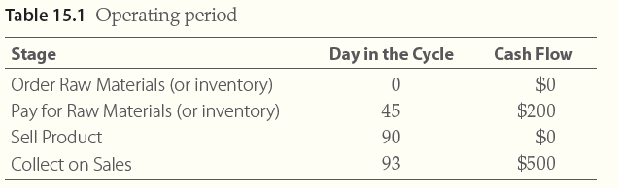
The Operating Period
Notes:
Table 15.1 from page 15.1.2 of text.

Slide 83

The Operating Period
Inventory period
  The time it takes to acquire and sell the inventory
Collection period
  The time from the sale of the product until funds are actually received from the buyer
Notes:
Note that both of these can vary significantly depending on industry and firm within industry.

Slide 84
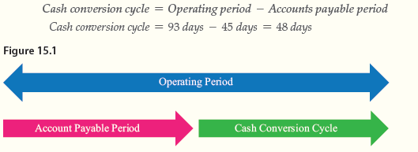
The Cash Conversion Cycle
Accounts payable period
  The time the vendor allows the firm to pay for raw materials
Notes:
Figure 15.1 from page 15.1.3 of text.

Slide 85
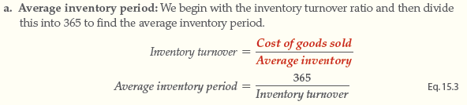
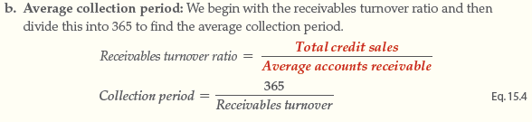
Calculating the Cash Conversion Cycle
Step 1: compute the operating period
  To compute operating period we need average inventory period and average collection period
Notes:
Formulae from page 15.1.4 of text.

Slide 86


Calculating the Cash Conversion Cycle
Step 2: Calculating the cash conversion cycle
Notes:
Note how the operating period and accounts payable period can impact the cash conversion cycle.

Slide 87
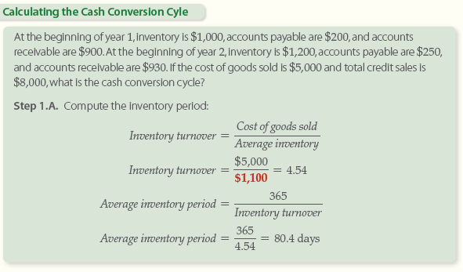
Calculating the Cash Conversion Cycle
Notes:
Solution tools on page 15.1.6 of text.

Slide 88
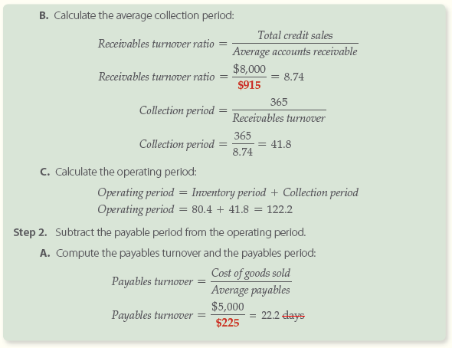
Calculating the Cash Conversion Cycle
Notes:
Examples from page 15.1.7 of text.

Slide 89
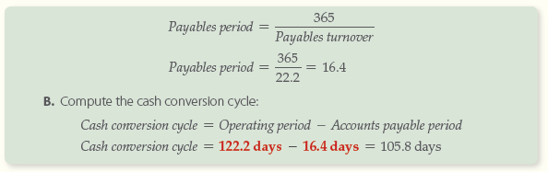
Calculating the Cash Conversion Cycle
Notes:
Note that, if you lengthened the accounts payable period, you would shorten the cash conversion cycle. However, keep in mind the trade discounts you may lose by stretching payables. From page 15.1.8 of text.

Slide 90

Using the Cash Conversion Cycle in Working Capital Management
Variables that impact the cash conversion cycle
Notes:
Discuss each one of these variables in detail and how changes will impact the cash conversion cycle. Table from page 15.1.9 of text.

Slide 91
LO2: How to Manage Inventory
Inventory represents a major asset for many firms
Typical manufacturing firms have at least 15% of assets in inventory
Retailers can have 25% or more of total assets in inventory
Notes:
Some retailers, such as auto dealers, can have even higher levels of assets in inventory.

Slide 92
3 types of Inventory
Raw materials
  Materials used in manufacturing process
Work in process
  Inventory that has been introduced to the manufacturing process
Finished goods
  Retailers hold goods ready to sell

Slide 93
Costs of Holding Inventory
Costs of holding inventory are called carrying costs and include:
  opportunity cost of funds tied up in inventory
  storage costs
  insurance costs
  cost of obsolescence, damage, and theft
Shortage Costs are incurred when inventory is too low and sales are missed.
Notes:
Spend some time addressing each of these components

Slide 94

Costs of Holding Inventory
Notes:
Figure 15.2 from page 15.2.3 of text. Note the assumption that inventory use is fairly stable and linear.

Slide 95


Optimal Inventory
Average inventory
Optimal Inventory Level
  Occurs when carrying cost is
  equal to reorder costs
Notes:
Figure 15.6 from page 15.2.5 of text

Slide 96


Computing the Economic Order Quantity
Economic order quantity (EOQ) model
  Best known and simplest method to compute optimal inventory level
Notes:
Works well when sales are consistent over time. Formulas from page 15.2.7 of text.

Slide 97

Computing the Economic Order Quantity
Economic order quantity (EOQ) model
  Best known and simplest method to compute optimal inventory level
Notes:
Equation from page 15.2.8 of text.

Slide 98

Computing the Economic Order Quantity
Notes:
Example from page 15.2.9 of text. Go over the problem in detail.

Slide 99

Computing the Economic Order Quantity
Adding a safety stock
  A minimum level of inventory a firm keeps on hand
  Ideally inventory will only fall below this level in emergencies
Notes:
EOQ with a safety stock to prevent shortage costs. Figure 15.4 from page 15.2.11 of text.

Slide 100
Other Inventory Methods
Basket method
  Inventory is separated into three bins (baskets) when it arrives
  The first bin is the normal operating inventory
  When the first bin is empty, new inventory is ordered and the firm operates out of the second bin
  The third bin is the safety stock
Notes:
Easy to use for small retailers

Slide 101
Other Inventory Methods
Just in time inventory method
  An alternative to holding inventory
  Parts and supplies are delivered just as the firm needs them
  This method increases the likelihood of stockout
Notes:
This method became very popular since it reduces investment in inventory, but can be costly when supply chain is disrupted. The Japanese earthquake and tsunami of 2011 highlighted this issue.

Slide 102
LO3: How to Manage Accounts Receivable
Accounts receivable turnover ratio
Average collection period
Why credit is offered
  Offering credit stimulates sales
  Trade credit is very common in many industries
Notes:
You can tie up a lot of money in A/R, so be cautious.

Slide 103
Developing a Credit Policy
Credit policy
  Stipulates how a firm will handle each phase of the credit decision
  This includes what goods will be sold on credit
Three elements of the typical credit sale:
  Credit period
  Discount amount
  Discount period

Slide 104
Developing a Credit Policy
Credit period
  The length of time the customer has before payment is due
  Varies among industries
  Typically between 30 and 120 days
Inventory period
  The length of time it takes the buyer to acquire, process and sell the inventory
Receivable cycle
  The length of time it takes to collect on a sale

Slide 105
Developing a Credit Policy
Factors to consider when establishing a credit policy
  Consumer demand for the product
  Whether the product is perishable or has continuing collateral value
  The credit risk of the buyer
  The competition in the market.
The effective annual rate for taking a cash discount
  Cash discounts are used to speed up the collection of accounts receivable
  Usual terms offer a 1% or 2% discounts for paying the balance within a short period
Notes:
Keep in mind that A/R is an investment and higher A/R will need more funds that must be obtained from someplace. So, lax credit policy may increase sales and the need for additional funds.

Slide 106
Developing a Credit Policy
Effective interest rate (EIR)
Notes:
EIR can be used to compute the cost of not taking advantage of trade credit discounts. Problem from page 15.3.5 of text.

Slide 107

Developing a Credit Policy
Cost of credit includes three factors
  Cost of holding increased current assets
  Bad debt losses
  Cost of administering the accounts receivable
Notes:
Note that there is some optimum level that balances these factors. Figure 15.5 from page 15.3.7 of text.

Slide 108
Developing a Credit Policy
Five Cs of credit analysis
  Character
    The willingness of the borrower to pay obligations owed
  Capacity
    The ability of the borrower to pay
  Capital
    The financial reserves of the firm
  Conditions
    The general economic and business climate
  Collateral
    The value of the assets that could be seized if the customer doesn’t pay on the debt
Notes:
The decision to extend credit is critical. A firm needs paying customers to stay in business, not losses for bad debts.

Slide 109
Developing a Credit Policy
Collection of accounts receivable (monitoring)
  Collection policy begins with careful monitoring of accounts receivable
Monitoring accounts receivable
  Average collection period
    Tells managers how long the average credit remains outstanding
    Important ratio used to track accounts receivable
Notes:
You need to watch the impact of your credit terms and you may need to adjust periodically if the economy changes.

Slide 110

Developing a Credit Policy
Aging schedule
  Another tool mangers use to evaluate the firms accounts receivable
Collection effort
  The firm follows a sequence of progressively more insistent steps
Notes:
Watching an aging schedule over time will help you spot credit problems in time to adjust credit policy. Table 15.3 from page 15.3.10 of text

Slide 111
LO4: How to Manage Cash
Disbursement float
  Occurs when there’s a delay between when the firm issues a check and when the funds are removed from the checking account
Collection float
  Occurs when there’s a delay between when you receive payment and when the bank gives you credit
Net float
  Net float is the difference between available balance and book balance

Slide 112

Electronic Funds Transfer (EFT)
EFT
  Broad term that refers to the transfer of funds around the world electronically, as opposed to a paper document
Notes:
Table 15.4 from page 15.4.3 of text. Note that EFT has eliminated a substantial amount of float.

Slide 113
Computing the Optimal Cash Balance
Reasons to hold cash
  Transactional motive
    The need to pay debts
  Precautionary motive
    The need for a safety supply to act as a financial reserve
  Speculative motive
    The need to take advantage of bargain purchases or opportunities that arise

Slide 114
LO5: Short Term Financing Alternatives
Bank Loans
  Supply short term funds needed for the firms operation
  The bank can charge fees
  The firm can be more flexible
Notes:
Evaluate all options and choose the least costly option.

Slide 115
Short Term Financing Alternatives
Self Liquidating Loans
  The loan is made to finance an asset that will pay off the loans
  Receivable financing
    Requires the firm to pledge its accounts receivable to the bank as collateral
  Inventory financing
    The firm borrows a portion of the value of its inventory

Slide 116
Short Term Financing Alternatives
Lines of Credit
  The total amount that can be borrowed is the firm’s line of credit
  Little effort is required by the firm to obtain a disbursement of funds

